Slide 1
Regresión Por Mínimos Cuadrados Parte II
Dr. Luis Sanchez

Slide 2
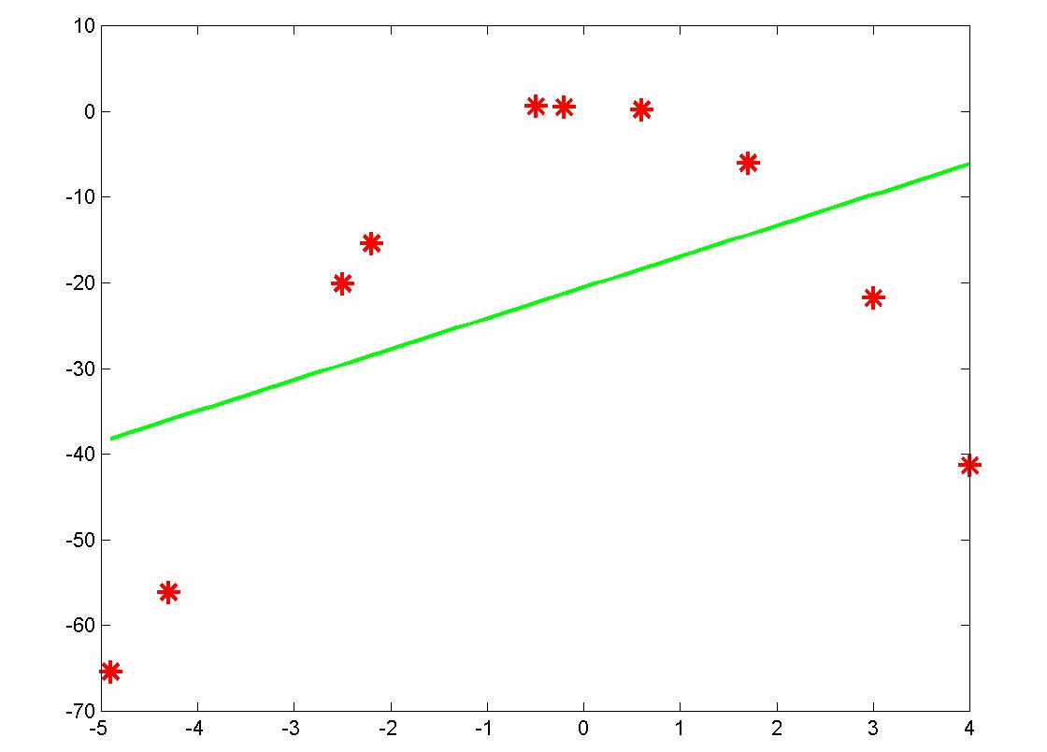
Introducción
x = [-2.5 3.0 1.7 -4.9 0.6 -0.5 4.0 -2.2 -4.3 -0.2];
y = [-20.1 -21.8 -6.0 -65.4 0.2 0.6 -41.3 -15.4 -56.1 0.5];
y = − 20.5717 +3.6005x
Error S_{r} = 4201.3
Correlation r = 0.4434

Slide 3
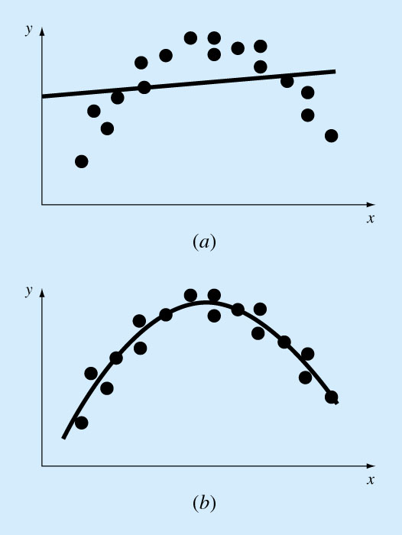
Polynomial Regression
Some engineering data is poorly represented by a straight line.
For these cases a curve is better suited to fit the data.
The least squares method can readily be extended to fit the data to higher order polynomials.
Large error, poor correlation
A parabola is preferable

Slide 4
Polynomial Regression (cont’d)
A 2nd order polynomial (quadratic) is defined by:
The residuals between the model and the data:
The sum of squares of the residual:

Slide 5
Polynomial Regression (cont’d)
3 linear equations with 3 unknowns (a_{o},a₁,a₂), can be solved

Slide 6
Polynomial Regression (cont’d)
A system of 3x3 equations needs to be solved to determine the coefficients of the polynomial.
The standard error & the coefficient of determination

Slide 7
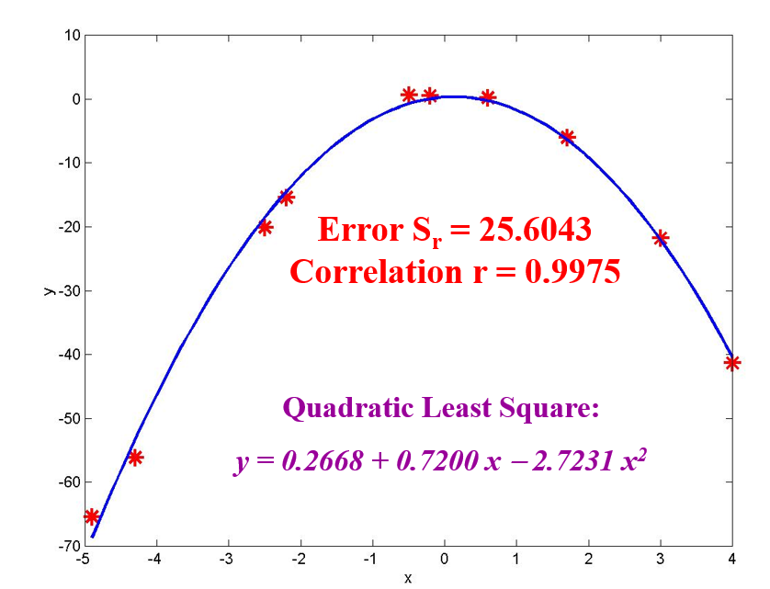
x = [-2.5 3.0 1.7 -4.9 0.6 -0.5 4.0 -2.2 -4.3 -0.2];
y = [-20.1 -21.8 -6.0 -65.4 0.2 0.6 -41.3 -15.4 -56.1 0.5];

Slide 8
Polynomial Regression (cont’d)
General:
The mth-order polynomial:
A system of (m+1)x(m+1) linear equations must be solved for determining the coefficients of the mth-order polynomial.
The standard error:
The coefficient of determination:

Slide 9
Polynomial Regression- Example
Fit a second order polynomial to data:
x_{i} | y_{i} | x_{i}² | x_{i}³ | x_{i}⁴ | x_{i}y_{i} | x_{i}²y_{i}
0 | 2.1 | 0 | 0 | 0 | 0 | 0
1 | 7.7 | 1 | 1 | 1 | 7.7 | 7.7
2 | 13.6 | 4 | 8 | 16 | 27.2 | 54.4
3 | 27.2 | 9 | 27 | 81 | 81.6 | 244.8
4 | 40.9 | 16 | 64 | 256 | 163.6 | 654.4
5 | 61.1 | 25 | 125 | 625 | 305.5 | 1527.5
15 | 152.6 | 55 | 225 | 979 | 585.6 | 2489

Slide 10
Polynomial Regression- Example (cont’d)
The system of simultaneous linear equations:

Slide 11
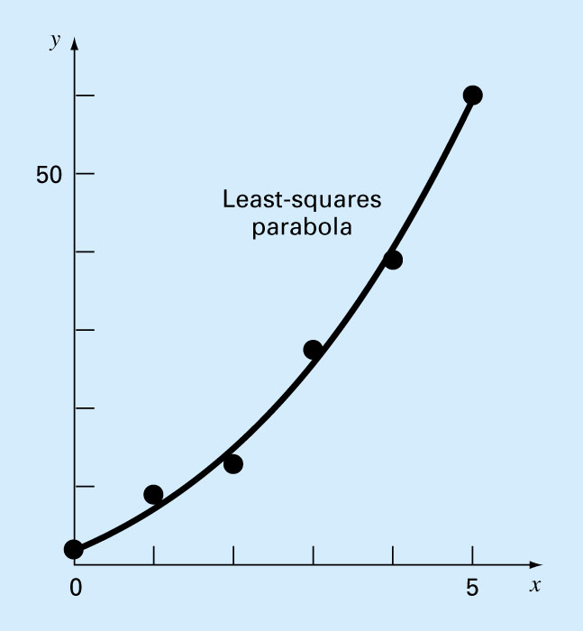
Polynomial Regression- Example (cont’d)
x_{i} | y_{i} | y_{model} | e_{i}² | (y_{i}-y`)²
0 | 2.1 | 2.4786 | 0.14332 | 544.42889
1 | 7.7 | 6.6986 | 1.00286 | 314.45929
2 | 13.6 | 14.64 | 1.08158 | 140.01989
3 | 27.2 | 26.303 | 0.80491 | 3.12229
4 | 40.9 | 41.687 | 0.61951 | 239.22809
5 | 61.1 | 60.793 | 0.09439 | 1272.13489
15 | 152.6 |  | 3.74657 | 2513.39333
The standard error of estimate:
The coefficient of determination:

Slide 12
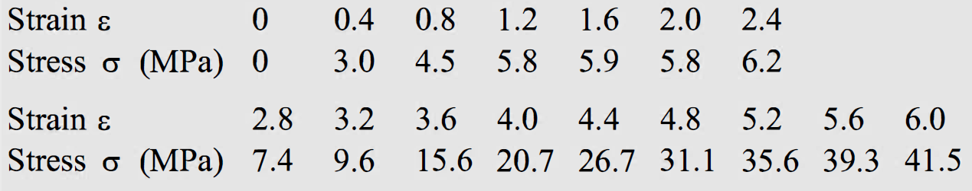
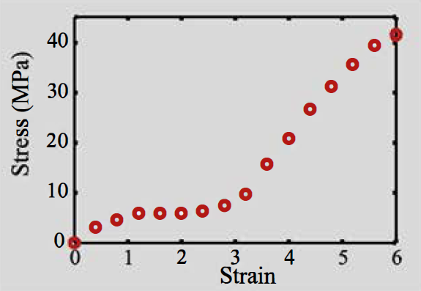
Exercice: Using polynomial regression for curve fitting of stress-strain curve.
A tension test is conducted for determining the stress-strain behavior of rubber. The data points from the test are shown in the figure, and their values are given below. Determine the fourth order polynomial that best fits the data points. Make plot of the data points and the curve that corresponds to the polynomial.

Slide 13

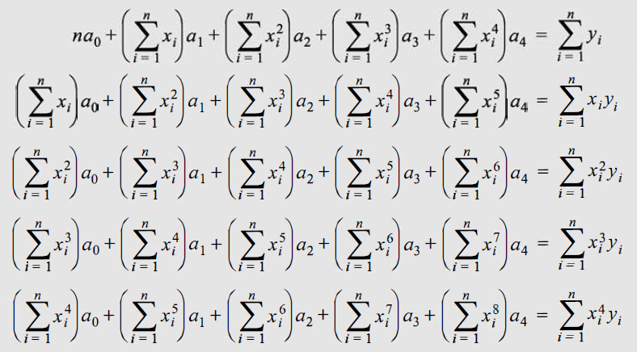
SOLUTION
A polynomial of the fourth order can be written as:
Curve fitting of 16 data points with this polynomial is done by polynomial regression. The values of the five coefficients a0, a1, a2, a3 , and a4 are obtained by solving a system of five linear equations. The five equations can be written:

Slide 14
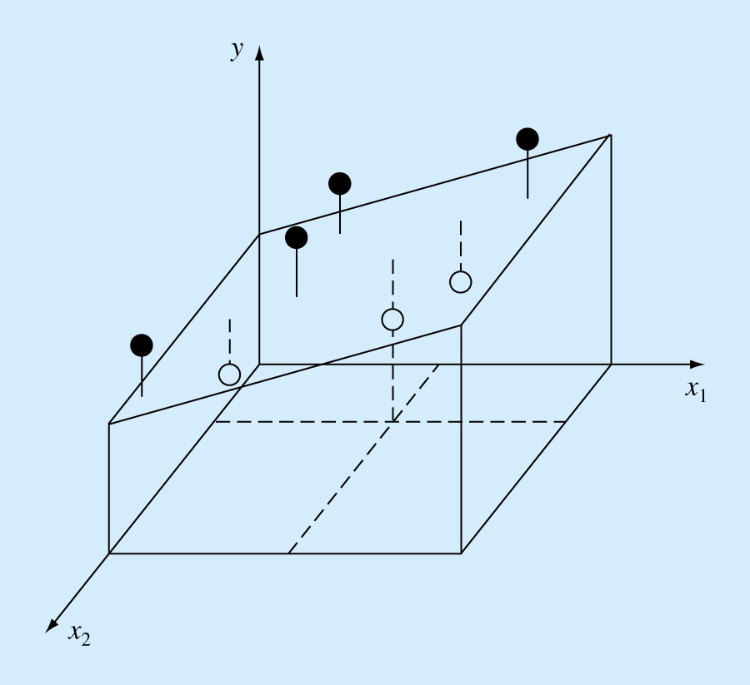
Multiple Linear Regression
A useful extension of linear regression is the case where y is a linear function of two or more independent variables. For example:
y = a_{o} + a₁x₁ + a₂x₂
For this 2-dimensional case, the regression line becomes a plane as shown in the figure below.

Slide 15
Multiple Linear Regression
Which method would you use to solve this Linear System of Equations?

Slide 16
Multiple Linear Regression
Example
The following data is calculated from the equation y = 5 + 4x₁ - 3x₂
Use multiple linear regression to fit this data.
Solution:
this system can be solved using
Gauss Elimination.
The result is: a₀=5 a₁=4 and a₂= -3
y = 5 + 4x₁ -3x₂
x₁ | x₂ | y
0 | 0 | 5
2 | 1 | 10
2.5 | 2 | 9
1 | 3 | 0
4 | 6 | 3
7 | 2 | 27

Slide 17
Multiple Linear Regression
Once again, solve by any matrix method
Cholesky decomposition is appropriate - symmetric and positive definite
Very useful for fitting power equation

Slide 18
Example: Strength of concrete depends on cure time and cement/water ratio (or water content W/C)

Slide 19
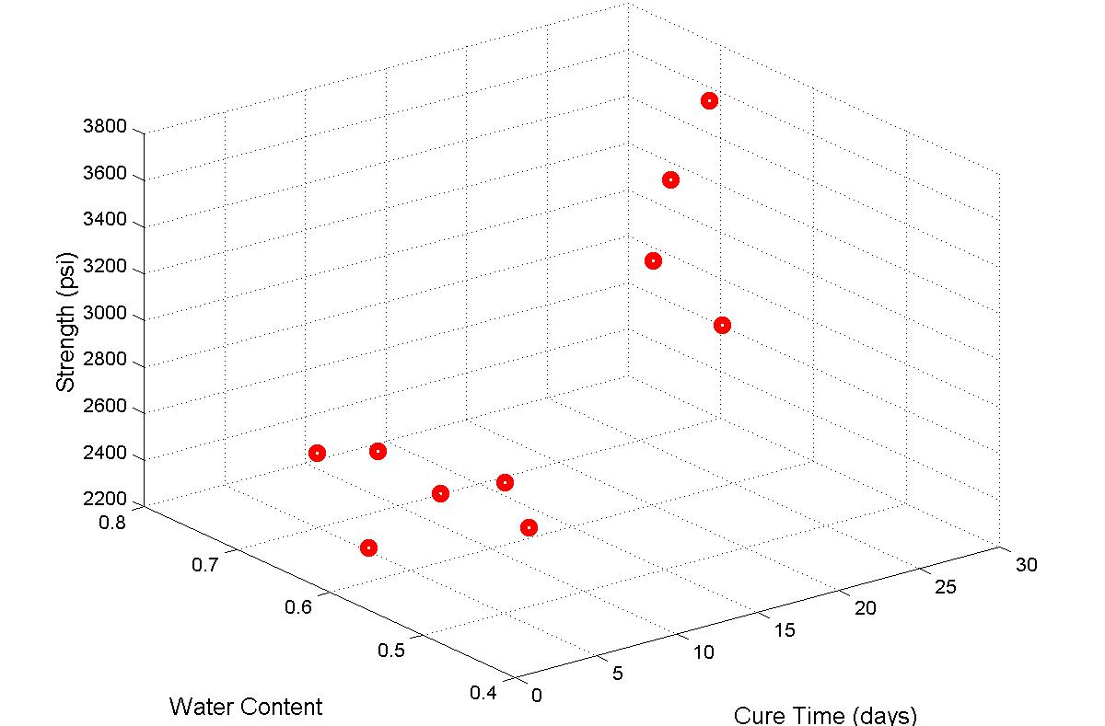
» x1=[2 4 5 16 3 7 8 27 14 20];
» x2=[0.42 0.55 0.7 0.53 0.61 0.67 0.55 0.66 0.42 0.58];
» y=[2770 2639 2519 3450 2315 2545 2613 3694 3414 3634];
» H=plot3(x1,x2,y,'ro'); grid on; set(H,'LineWidth',5);
» H1=xlabel('Cure Time (days)'); set(H1,'FontSize',12)
» H2=ylabel('Water Content'); set(H2,'FontSize',12)
» H3=zlabel('Strength (psi)'); set(H3,'FontSize',12)

Slide 20
Hand Calculations

Slide 21
Solve by Cholesky decomposition
Forward and Back Substitutions

Slide 22
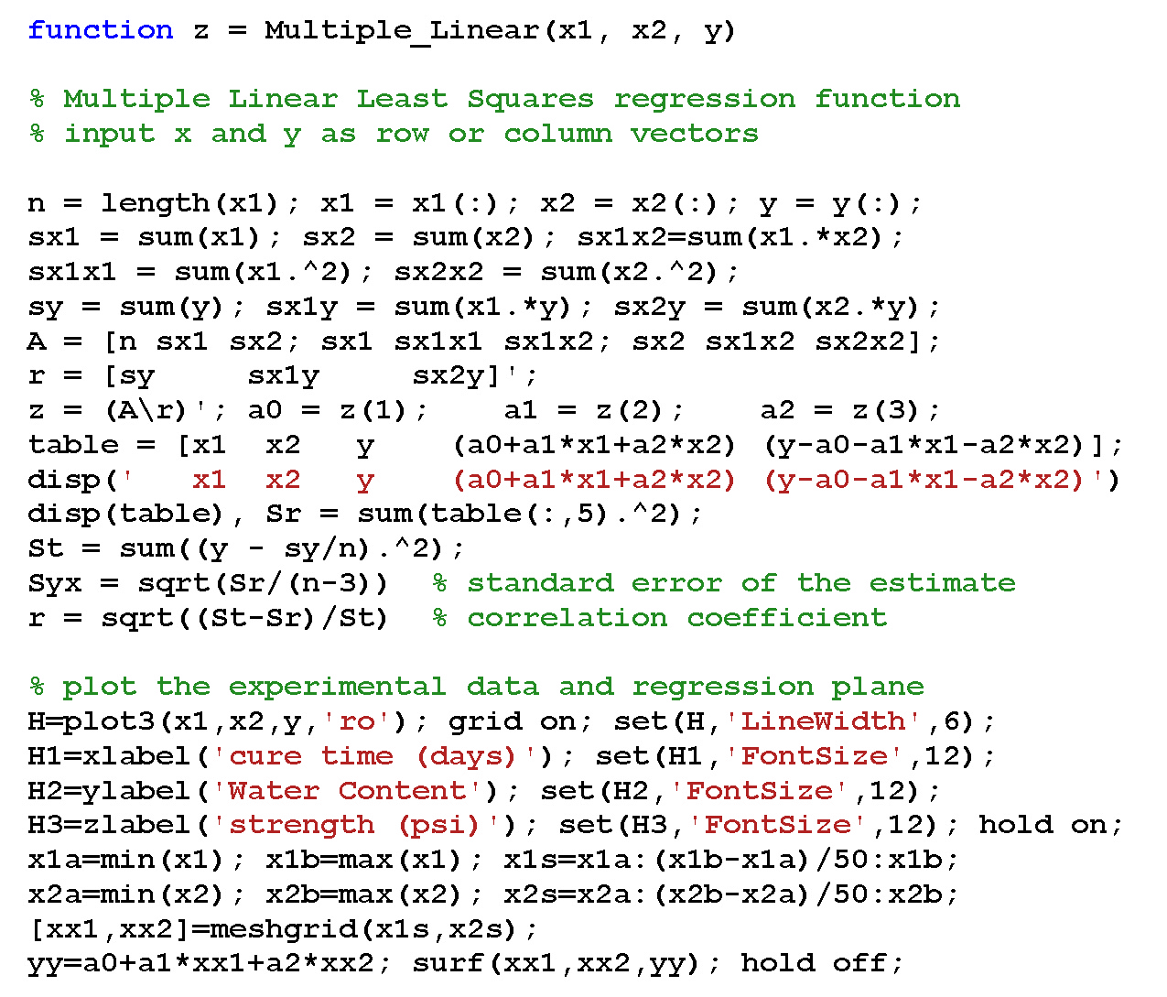

Slide 23
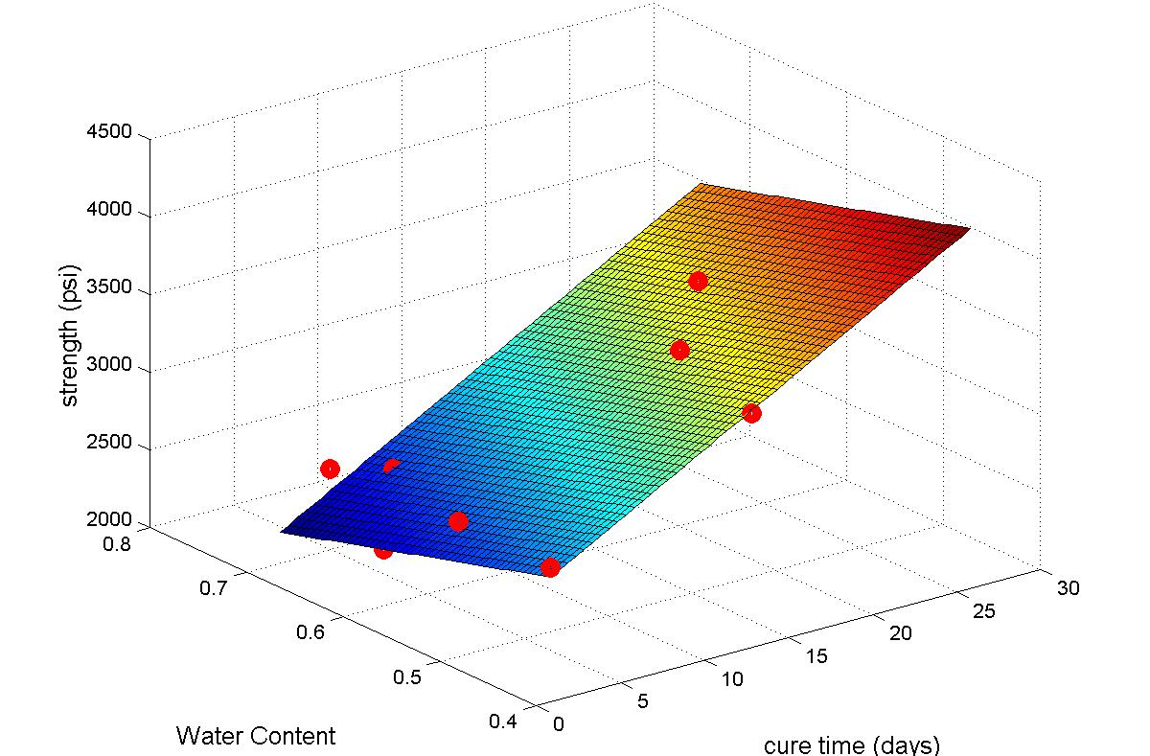
Multiple Linear Regression

